Slide 1
CSC 112: Computer Operating Systems Lecture XX IO
Department of Computer Science,
Hofstra University
Acknowledgement: Lecture slides based on UC Berkeley CS 162: Operating Systems and System Programming

Slide 2



Resources
So far we considered:
CPU
main memory
In the next lecture
background storage
Today: I/O devices
CPU
main memory (RAM)
I/O devices
I/O interfaces
secon- dary storage

Slide 3

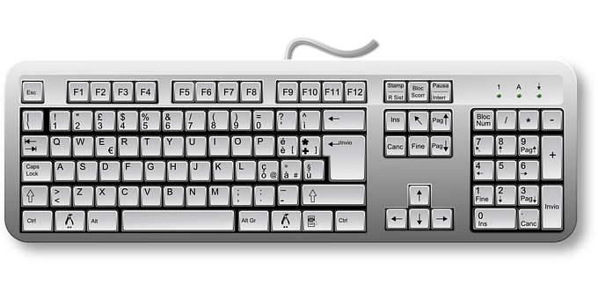
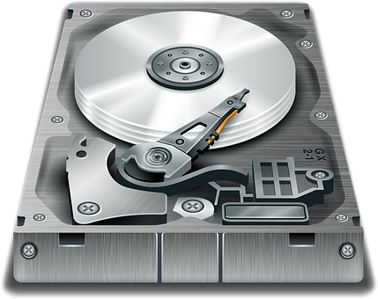
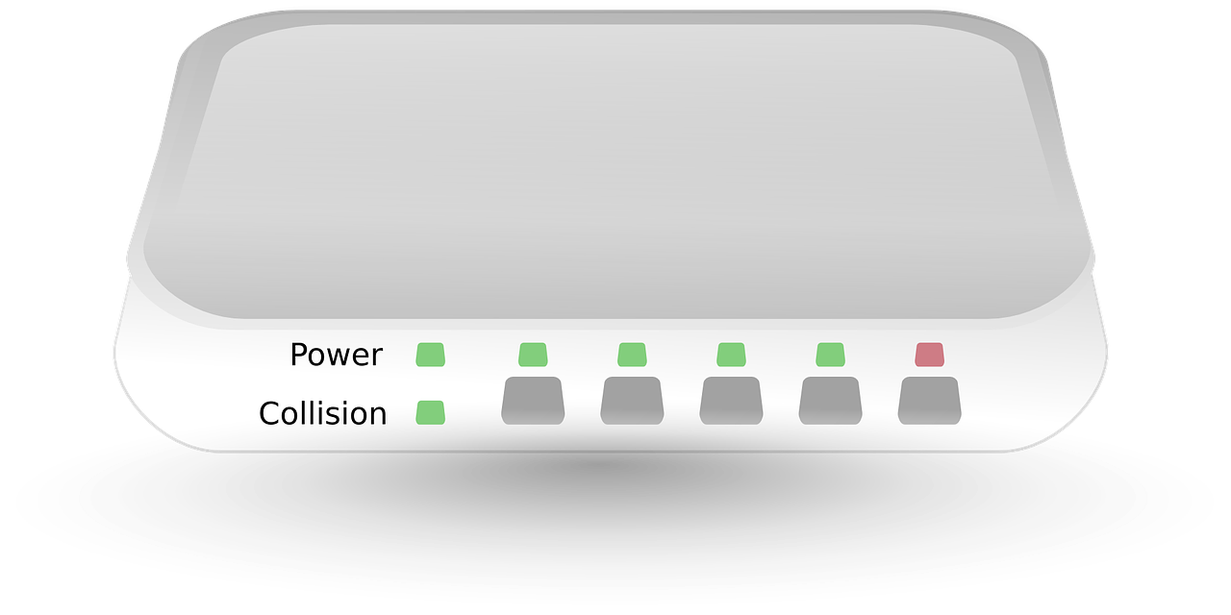
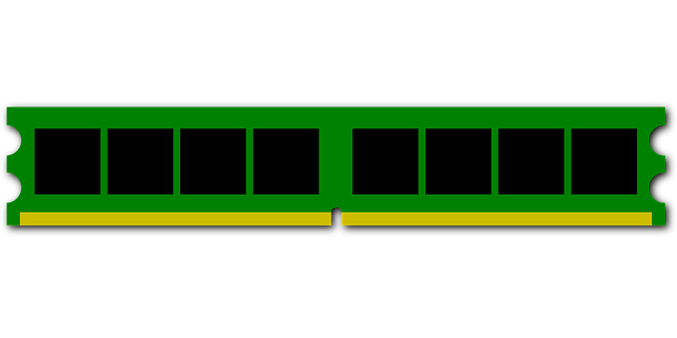
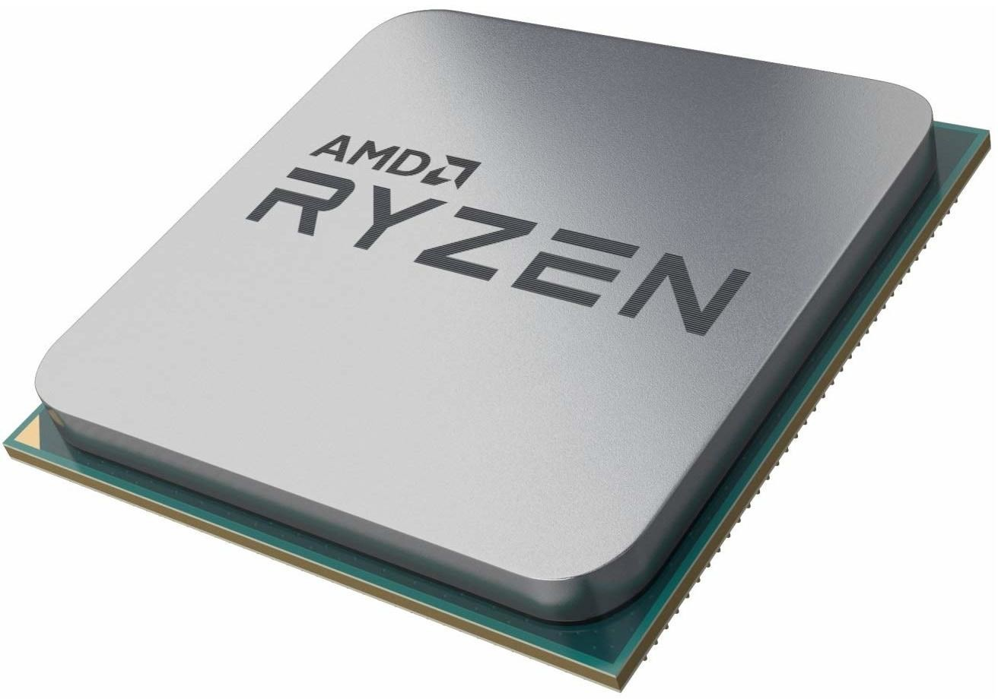
I/O device interfacing
Video controller
Disk controller
Ethernet controller
Keyboard controller
Bus
Input/output devices are connected to the system bus via a controller.
They are programmed using
I/O registers in the controllers.
main memory (RAM)
CPU

Slide 4


Example: PC keyboard
Serial communication, character oriented
Control codes
e.g. for LEDs
Make and break codes indicate pressed/released keys
Tasks of the software:
Initialization of the controller
Fetch characters from the keyboard
Send command (e.g. for switching LEDs)
keyboard controller
The controller signals an interrupt as soon as a character is available
Notes:
Keyboards are "intelligent" (have their own processor)

Slide 5

Example: CGA video controller
Communication via video signal
analog: VGA, digital: DVI, HDMl, DisplayPort
Transformation of the contents of the frame buffer (screen memory) into a picture (e.g. 80x25 character matrix or bitmap)
Video signal, e.g.: RGB, Intensity, VSync, HSync
CGA video controller
0 1 2
…
79
control and status regs.
0
A
B
C
:
:
24
frame buffer
Tasks of the software:
Initialization of the controller
Set and switch video modes
Fill frame buffer with content
Control the cursor position
Enable/disable the cursor

Slide 6


Example: IDE disk controller
Communication via AT commands
Blockwise random access to data blocks
AT commands
Calibrate disk drive
Read/write/verify block
Format track
Position disk read/write head
Diagnosis
Configure disk parameters
IDE disk controller
control and status regs.
Sector buffer
Data blocks
(512 bytes each)
The disk controller signals an interrupt as soon as the sector buffer has been read or written
Tasks of the software:
Write AT commands to registers
Fill/empty sector buffer
React to interrupts
Error handling

Slide 7

Example: Ethernet controller
Serial packet-based bus communication
Packets have variable size and contain addresses:
preamble+SFD | destination | source | type | data ……………… | CRC
0–1500 bytes
Ethernet controller
Interrupt after the completion
of each operation
gather
DMA
Bus
Tasks of the software:
Provide data and buffers
Initialize controller registers
React to interrupts
Error handling
scatter
Memory access via scatter/gather bus master DMA
main memory (RAM)

Slide 8
Device classes
Character devices
Keyboard, printer, modem, mouse, ...
Usually only sequential access, rarely random access
Block devices
Hard disk, CD-ROM, DVD, tape drives, ...
Usually blockwise random access
Other devices don’t fit this scheme easily, such as
(GP)GPUs (especially 3D acceleration)
Network cards (protocols, addressing, broadcast/multicast, packet filtering, ...)
Timer (sporadic or periodic interrupts)
...

Slide 9



Interrupts
…signal the software to become active
Interrupt processing sequence on hardware level
Software can disable IRQ handling
For x86:
sti → enable
cli → disable
1. Device has completed operating
3. CPU confirms start of interrupt handling ("acknowledge")
→ ("interrupt request", IRQ)
Interrupt controller
CPU
2. Controller signals interrupt request
Bus
4. Controller communicates the number of the interrupt ("interrupt vector") to the CPU

Slide 10



Direct Memory Access (DMA) ...
is used by complex controllers to transfer data from and to main memory independent of the CPU
DMA transfer sequence
1. CPU configures DMA controller
4. ACK
DMA
controller
Disk controller
address
data buffer
count
CPU
control
main memory
2. DMA controller requests data
3. Data transfer
(RAM)
Interrupt
when all is done
Bus
Steps 2., 3. and 4. are repeated count times

Slide 11
I/O address space
Access to controller registers and controller memory depends on the system architecture
two address spaces one address space two address spaces
memory
0xffffffff
I/O ports
0
(a)
(b)
(c)
Separate I/O address space
accessible using special machine instructions
Shared address space (memory mapped I/O)
Hybrid architecture

Slide 12
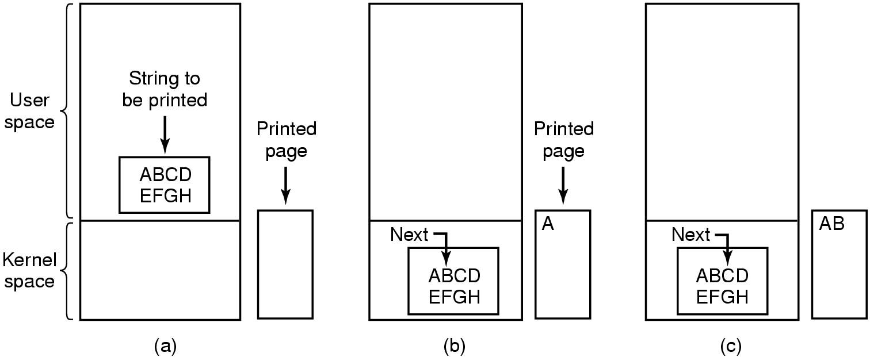
Device drivers
Depending on the device, I/O can be performed via
Polling ("programmed I/O"),
Interrupts or
DMA
Example: Printing a page of text
Source: Tanenbaum, Modern Operating Systems

Slide 13
Polling ("programmed I/O")
... implies active waiting for an I/O device
/* Copy character into kernel buffer p */ copy_from_user (buffer, p, count); /* Loop over all characters */ for (i=0; i<count; i++) { /* Wait “actively” until printer is ready */ while (*printer_status_reg != READY);
/* Print one character */ *printer_data_reg = p[i]; } | Pseudo code of an operating system function to print text using polling
return_to_user ();

Slide 14
Interrupt-driven I/O
... implies that the CPU can be allocated to another process while waiting for a response from the device
copy_from_user (buffer, p, count);
/* Enable printer interrupts */ enable_interrupts ();
/* Wait until printer is ready */ while (*printer_status_reg != READY);
/* Print first character */
*printer_data_reg = p[i++];
scheduler (); return_to_user ();
if (count > 0) {
*printer_data_reg = p[i]; count--;
i++;
} else { unblock_user ();
}
acknowledge_interrupt (); return_from_interrupt ();
Code to initiate the I/O operation
Interrupt handler

Slide 15
DMA-driven I/O
... the CPU is no longer responsible for transferring data between the I/O device and main memory
further reduction of CPU load
copy_from_user (buffer, p, count); set_up_DMA_controller (p, count); scheduler ();
return_to_user ();
acknowledge_interrupt (); unblock_user (); return_from_interrupt ();
Code to initiate the I/O operation
Interrupt handler

Slide 16
Discussion: Interrupts
Saving the process context
Partly performed directly by the CPU
e.g. saving status register and return address
minimal required functionality
All modified registers have to be saved before and restored after the end of interrupt processing
Keep interrupt processing times short
Usually other interrupts are disabled while an interrupt handler is executed
Interrupts can get lost
If possible, the OS should only wake up the process that was waiting for the I/O operation to finish

Slide 17
Discussion: Interrupts (2)
Interrupts are the source for asynchronous behavior
Can cause race conditions in the OS kernel
Interrupt synchronization
Simple approach: disable interrupts "hard" while a critical section is executed
x86: instructions sti and cli
Again, interrupts could get lost
In modern systems, interrupts are realized using multiple stages. These minimize the amount of time spent with disabled interrupt
UNIX: top half, bottom half
Linux: Tasklets
Windows: Deferred Procedures

Slide 18
Discussion: Direct Memory Access
Caches
Modern processors use data caches
DMA bypasses the cache!
Before a DMA transfer is configured, cache contents must be written back to main memoy and the cache invalidated
Some processors support non-cachable address ranges for I/O operations
Memory protection
Modern processors use a MMU to isolate processes from each other and to protect the OS itself
DMA bypasses memory protection!
Mistakes setting up DMA transfers are very critical
Application processes can never have direct access to program the DMA controller!

Slide 19
Tasks of the OS
Create device abstrations
Uniform, simple, but versatile
Provide I/O primitives
Synchronous and/or asynchronous
Buffering
If the device or the receiving process are not yet ready
Device control
As efficient as possible considering mechanical device properties
Handle resource allocation
For multiple access devices: which process may read/write where?
For single access devices: time-limited reservation
Manage power saving modes
Support plug&play
...

Slide 20
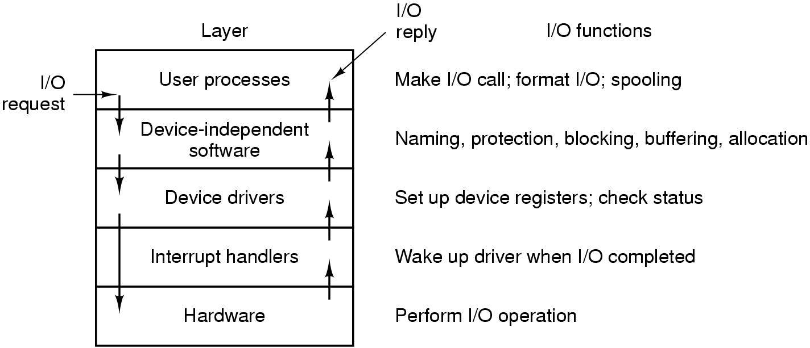
Layers of the I/O system
Source: Tanenbaum, "Modern Operating Systems"

Slide 21
Unix device abstractions
Peripheral devices are realized as special files
Devices can be accessed using read and write operations in the same way as regular files
Opening special files creates a connection to the respective device provided by the device driver
Direct access to the driver by the user
Block oriented special files (block devices)
Disk drives, tape drives, floppy disks, CD-ROMs
Character oriented special files (character devices)
Serial interfaces, printers, audio channels etc.

Slide 22
Unix device abstractions (2)
Devices are uniquely identified by a tuple:
device type
block or character device
major device number
selects one specific device driver
minor device number
selects one of multiple devices controlled by the device driver identified by the major number

Slide 23
Unix device abstractions (3)
Partial listing of the /dev directory that by convention holds the special files:
brw-rw---- | me | disk | 3, | 0 | 2008-06-15 | 14:14 | /dev/hda
brw-rw---- | me | disk | 3, | 64 | 2008-06-15 | 14:14 | /dev/hdb
brw-r----- | root | disk | 8, | 0 | 2008-06-15 | 14:13 | /dev/sda
brw-r----- | root | disk | 8, | 1 | 2008-06-15 | 14:13 | /dev/sda1
crw-rw---- | root | uucp | 4, | 64 | 2006-05-02 | 08:45 | /dev/ttyS0
crw-rw---- | root | lp | 6, | 0 | 2008-06-15 | 14:13 | /dev/lp0
crw-rw-rw- | root | root | 1, | 3 | 2006-05-02 | 08:45 | /dev/null
lrwxrwxrwx | root | root |  | 3 | 2008-06-15 | 14:14 | /dev/cdrecorder -> | hdb
lrwxrwxrwx | root | root |  | 3 | 2008-06-15 | 14:14 | /dev/cdrom -> hda
access permissions
owner and major and group minor ID
modification date&time
name of the special file
c: character device
b: block device
l: link

Slide 24
Unix access primitives
A quick overview... (see the man pages for details...)
int open(const char *devname, int flags)
"opens" a device and returns a file descriptor
off_t lseek(int fd, off_t offset, int whence)
Positions the read/write pointer (relative to the start of the file) – only for random access files
ssize_t read(int fd, void *buf, size_t count)
Reads at most count bytes from descriptor fd into buffer
buf
ssize_t write(int fd, const void *buf, size_t count)
Writes count bytes from buffer buf to file with descriptor fd
int close(int fd)
"closes" a device. The file descriptor fd can no longer be used after close

Slide 25
Unix device specific functions
IOCTL(2) Linux Programmer's Manual
NAME
ioctl - control device
SYNOPSIS
#include <sys/ioctl.h>
int ioctl(int d, int request, ...);
Special properties of a devices are controlled via ioctl:
IOCTL(2)
Generic interface, but device-specific semantics:
CONFORMING TO
No single standard. Arguments, returns, and semantics of ioctl(2) vary according to the device driver in question (the call is used as a catch-all for operations that don't cleanly fit the Unix stream I/O model). The ioctl function call appeared in Version 7 AT&T Unix.

Slide 26
Unix: waiting for multiple devices
So far, we have encountered blocking read and write calls
What can we do if we need to read from several sources (devices, files) at the same time?
Alternative 1: non-blocking input/output
Pass the O_NDELAY flag to the open() system call
Polling operation: the process has to call read() repeatedly until data arrives
Suboptimal solution that wastes CPU time

Slide 27
Unix: waiting for multiple devices (2)
Alternative 2: blocking wait for multiple file descriptors
System call:
int select (int nfds, fd_set *readfds, fd_set *writefds,
fd_set *errorfds, struct timeval *timeout);
nfds defines the maximum file descriptor which select should consider
…fds indicates the file descriptors to wait on:
•
readfds — wait on these until data is available
writefds — …until data can be written
errorfds — …until an error is signaled
timeout defines the time at which select unblocks if no other event occurred
Macros are provided to create the file descriptor sets
Result of select: the descriptor sets only contain those descriptors which resulted in the deblocking of the call

Slide 28
Buffering of I/O operations
Problem if an operating system does not provide data buffers:
Data which arrives before a corresponding read operation is executed (e.g. keyboard input) would get lost/discarded
If an output device is busy, write would either fail or block the process until the device is ready again
A process executing an I/O operation cannot be swapped
operating system
user process
I/O device
read
a) read operation without buffering

Slide 29
Single I/O buffers
Read
The OS can accept data even if the reader process has not executed read yet
For block devices, a subsequent block can already be prefetched
The process can now be swapped, DMA writes to a buffer
Write
Data is copied, the caller does not block. Data buffers in the user address space can immediately be reused
operating system user process
I/O device
read
move
b) read operation with single buffering
Operating Systems 14: Input and output

Slide 30
Single I/O buffers
Read
•
The OS can accept data even if the reader process has not
executed read yet
For block devices, a subsequent block can already be prefetch
The process can now be swapped, DMA writes to a buffer
Write
Data is copied, the caller does not block. Data buffers in the us address space can immediately be reused
operating system user process
_{I/O} read move
device
Performance estimation
A simple back-of-the envelope calculation gives an indication of the
ed
performance increase when repeatedly reading blockwise with
subsequent processing:
•
T:
Duration of the read operation Compute time required for processing
Duration of the copy process (system buffer→user process) Overall time required for reading and processing a block
er
C:
M:
B:
Without buffer: With buffer:
B0 = T + C
BE = max (T, C) + M
For T ≈ C und M ≈ 0, B0 ≈ 2·BE. Unfortunately, M > 0
b) read operation with single buffering
Operating Systems 14: Input and output

Slide 31
Double I/O buffering
Read
While data is transferred from the I/O device to one of the buffers, the contents of the other buffer can be copied into the user address space
Write
While data is transferred from one of the buffers to the I/O device, the contents of the other buffer can already be refilled with data from the process address space
operating system user process
I/O device
read
move
c) read operation with double buffering
Operating Systems 14: Input and output

Slide 32
Double I/O buffering
Read
•
While data is transferred from the I/O device to one of the
buffers, the contents of the other buffer can be copied int the user address space
Write
While data is transferred from one of the buffers to the I/ device, the contents of the other buffer can already be refilled with data from the process address space
operating system user process
_{I/O} read move
Performance estimation
o
A double buffer enables to execute a read operation in parallel to a copy operation and processing
•
•
O
Without buffer:
B0 = T + C
BE = max (T, C) + M BE = max (T, C + M)
With buffer:
With double buffer:
If C + M < T, the device could be utilized to 100%
device
c) read operation with double buffering
Operating Systems 14: Input and output

Slide 33
I/O ring buffers
Read
Multiple (many) data blocks can be buffered, even if the reading process does not call read fast enough
Write
A writer process can execute multiple write calls without being blocked
operating system
user process
I/O device
read
move
d) read operation with ring buffer

Slide 34
Discussion: I/O buffers
I/O buffers decouple the I/O operations of user processes from the device driver
This enables to handle an increased rate of I/O requests for a short duration
In the long run, no amount of buffers can avoid a blocking of processes (or the loss of data)
Buffers create overhead
Management of the buffer structure
Space in memory
Time required for copying
In complex systems data can be buffered multiple times
Example: between layers of network protocols
Avoid if possible!

Slide 35
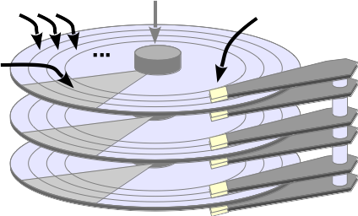
Device control example: disk
Driver has to consider mechanical properties!
Disk drivers usually queue multiple requests
The order of request execution can increase efficiency
The time required to process a request consists of:
Positioning time:
Rotational delay:
Transfer time:
depends on current position of the disk head arm time until the sector passes by the read/write head time required to transfer the data
Optimization criterium:
positioning time
Sector
Tracks
Rotation axis
Read/write
heads

Slide 36
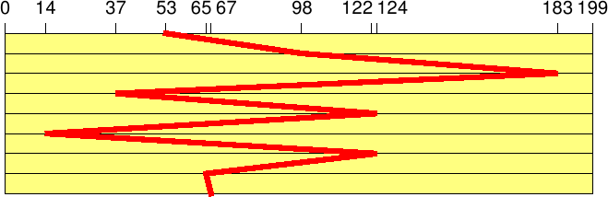
I/O scheduling: FIFO
Process requests in order of their arrival (first in first out)
Reference sequence (sequence of track numbers): 98, 183, 37, 122, 14, 124, 65, 67
Current track: 53
Total number of track changes: 640
Large movements of the disk arm: long average processing time!

Slide 37
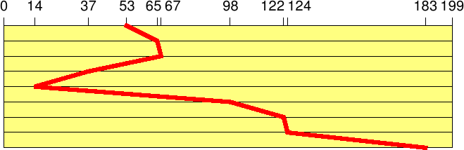
I/O scheduling: SSTF
The request with the shortest processing time is prioritized (shortest seek time first)
Same reference sequence
(Assumption: positioning time proportional to track distance)
Total number of track changes: 236
Similar to SJF scheduling, SSTF can also lead to starvation!
still not optimal

Slide 38
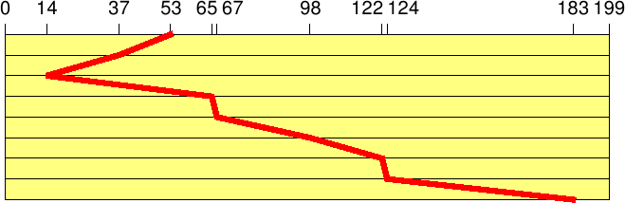
I/O scheduling: Elevator
Move the disk arm in one direction until no more requests are available (elevator scheduling)
Same reference sequence
(assumption: head moves in direction 0)
Total number of track changes: 208
New requests executed without additional positioning time
No starvation, but long waiting times are possible

Slide 39
Discussion: I/O scheduling today
Disks are "intelligent" devices
Physical properties are hidden (logical blocks)
Disks have huge caches
Solid State Disks no longer contain mechanical parts
I/O-scheduling slowly loses relevance
Success of a given strategy is more difficult to predict
Nevertheless, I/O scheduling is still very important
CPU speeds increase further, disk speeds do not
Linux currently implements two different variants of the
elevator algorithm (+ FIFO for "disks" without positioning time):
DEADLINE: prioritizes read requests (shorter deadlines)
COMPLETE FAIR: all processes get an identical fraction of the I/O bandwidth

Slide 40
Conclusion
I/O hardware comes in very many different variants
sometimes difficult to program
The "art" of designing an OS consists of...
nevertheless defining uniform and simple interfaces
using the hardware efficiently
maximizing CPU and I/O device utilization
The availability of a large number of device drivers is extremely important for the success of an operating system
Device drivers are by far the largest subsystem in Linux and Windows

Slide 41
6.5 Disk scheduling (6 points)
a. Assume a magnetic disk with 8 tracks. After each second read request
(starting from L1), the I/O scheduler receives additional read requests
which are grouped (requested) together (L2 and finally L3).
Initially, the read/write head of the disk is at track 0.
Give the I/O scheduling order that would be performed according to the
SSTF (shortest seek time first) algorithm:
L1 = {2,4,3,1},L2 = {5,6},L3 = {0,7}
Access order:
b. Assume the same magnetic disk as above. The read requests in L1 are
already known to the disk scheduler. After three completed requests,
the requests in L2 arrive, and after three additional requests (i.e., after
the sixth request), the requests in L3 arrive.
Initially, the read/write head of the disk is at track 0.
Give the I/O scheduling order that would be performed according to the
elevator algorithm:
L1 = {1,4,7,2},L2 = {4,6,0},L3 = {5,2

